Slide 1

TOP Hit Prediction
Applied Data Science

Slide 2
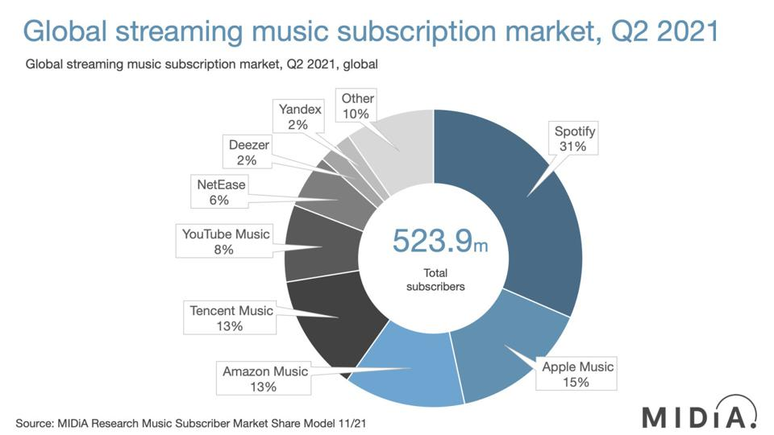
Notes:
Source: Forbes
https://www.forbes.com/sites/eamonnforde/2022/01/19/spotify-comfortably-remains-the-biggest-streaming-service-despite-its-market-share-being-eaten-into/?sh=6f71a5134743

Slide 3
SCOPE Identify Possible top hits based on song features
Background: Traditionally the music industry has relied on gut feelings and intuition to identify potential hits, but now data science techniques can be used to analyze song features and predict which songs are most likely to become popular/top hit.
Objectives: By analyzing the song features such as tempo, danceability, energy, and others, we aim to understand the characteristics that make a song popular. This information can be useful for music streaming platforms, record labels, and artists to make informed decisions about their music releases and marketing strategies.
Model evaluation: We will compare different models regarding accuracy, precision, especially recall.

Slide 4
SCOPE Identify Possible top hits based on song features
Data sources: we used four Spotify datasets provided by Kaggle. The datasets are:
3 data sets of the “Spotify Dataset 1921-2020, 600k+ Tracks”
artists.csv → Artist features like Popularity, Followers etc.
dict_artists.json → The artists recommended for fans of artists.
tracks.csv → The audio features of tracks.
1 data set of “Spotify tracks chart dataset (2014-2022)”
charts.csv → This dataset is comprised of weekly Spotify track chart data from 2014 to 2022. Used to get the chart position of the song in various countries.

Slide 5
Variable LIST
NAME | Description
Popularity | Measurement: Derived from absolute & recent number of streams
Energy | Liveliness of the song
Loudness | Derived from decibel measurements of the song
Liveness | Degree to which the song sounds like it was record live vs. studio produced
Danceability | Measurement of how easy it is to dance to the song
Speechiness | Measurement of words spoken
Instrumentalness | Measurement of instrumental sounds within the song
Valence | Measurement of the positivity of the song
Mode | Indication of modality (major or minor)
Explicit | Indication whether the song contains swear words (yes or no)
Key | Standard pitch class notation (C to H)

Slide 6

Domain Exploration - Hit Song Science
Area first defined by Mike McCready in 2002 (CEO of Polyphonic)
Goal/Business Model:
Evaluate Hits before they are released
Identify & match musical preferences of certain groups
Original Procedure: Analyze mathematical structure of rhythm, changes in key & melodic pattern
Notes:
Brief literature review about domain and previous data science projects in this domain
Sources:
Ruth Dhanaraj; Beth Logan (2005) „AUTOMATIC PREDICTION OF HIT SONGS”
Internet → Web Archive 2005:
https://hitsongscience.com/
http://www.polyphonichmi.com/about_us.php

Slide 7
Domain Exploration – Previous Data Science Projects
Goals | Input | Features | Methods | Result
Predict Song Popularity (>90%) | SF Developer Application Programming Interface | Explicitness, Instrumentals, Danceability | KNN, Random Forest, Gradient Boosted Trees, Logistic Regr. | Max. 72% Accuracy
Predict Hit in Billboard Hot 100 | Million Song Data Set (MSD), SF API (Extra) | All API Features & Artist Score (Custom) & Release Tiem | EM, LR, GDA, SVM, DT and NN (RF) | 69 - 77% Accuracy (81 – 89% Accuracy)
Determine Variation of Attributes to Streams | Spotify API (Custom Python Code) | Genre (SF) & All API Features | Correlation Analysis, Linear Regression | Low Explanatory Power
Determine Variation of Attributes to Popularity | Spotify WEB API (Custom Code) ONE Artist | All API Features | Beta regression model, GLMM, Beta GLMM | Mixed Explanatory Power (some Pos, some neg, rest irrelev)
Determine Features of Successful Playlists | Spotify & Surveys |  | Plotting | Intimacy, Focus & Variety
Characterize Trendy Music Clusters | Spotify API | All API Features | KNN | Variety of Size & Attributes
Notes:
Sources:
L1: Dawson, Christopher E. Jr.; Mann, Steve; Roske, Edward; and Vasseur, Gauthier (2021) "Spotify: You have a Hit!," SMU Data Science Review: Vol. 5: No. 3, Article 9.
L2: Georgieva, Elena; Suta Marcella; Burton, Nicholas: “HITPREDICT: PREDICTING HIT SONGS USING SPOTIFY DATA” (2018)
L2,5: Middlebrook, Kai; Sheik, Kian: „SONG HIT PREDICTION: PREDICTING BILLBOARD HITS USING SPOTIFY DATA “ (2019)
L3: Nijkamp, Rutger “Prediction of product success: explaining song popularity by audio features from Spotify data” (2018)
L4: Spera, Carola; Sciandra, Marangela “A Model Based Approach to Spotify Data Analysis: A Beta GLMM” (2020)
L5: George John Jordan Thomas Aquinas Hayward „What makes a playlist succesful? “ (https://ghayward.github.io/assets/files/Data_Scientist_Presentation_George_JJTA_Hayward.pdf)
L6: http://www.na-businesspress.com/JMDC/JMDC14-3/8_Al-BeitawiFinal.pdf
TBD: Methoden + Datensätze + Selected Features
Abkürzungen:
Expectation Maximization (EM), Logistic Regression (LR), Gaussian Discriminant Analysis (GDA), Support Vector Machines (SVM), Decision Trees (DT), and Neural Networks (NN)
Random Forest (RF)
Generalized Linear Mixed Models (GLMM)
All API Features:
Danceability, Energy, Speechiness, Acousticness, Instrumentalness, Liveness, Valence, Loudness, and Tempo
Duration, Mode

Slide 8

Domain Exploration
Go for Use Case
Decision of Data Base
Limitations:
Bias due to Spotify API
Limited to Data Base Info e.g. No Genre
No Details of Calculation
Excludes Soft Factors

Slide 9
Domain Exploration – Previous Data Science Projects
Goals | Input | Result
Predict Song Popularity (>90%) | Spotify API | Max. 72% Accuracy
Predict Hit in Billboard Hot 100 | Spotify API & Million Song Data Set (MSD) | 69 - 77% Accuracy 81 – 89% Accuracy
Determine Variation of Attributes to Streams | Spotify API | Low Explanatory Power
Determine Variation of Attributes to Popularity | Spotify API | Mixed Explanatory Power
Determine Features of Successful Playlists | Spotify API & Surveys | Intimacy, Focus & Variety
Characterize Trendy Music Clusters | Spotify API | Variety of Size & Attributes
Multiple Approaches
Different Goals & Data Input
Different Results
Notes:
Sources:
L1: Dawson, Christopher E. Jr.; Mann, Steve; Roske, Edward; and Vasseur, Gauthier (2021) "Spotify: You have a Hit!," SMU Data Science Review: Vol. 5: No. 3, Article 9.
L2: Georgieva, Elena; Suta Marcella; Burton, Nicholas: “HITPREDICT: PREDICTING HIT SONGS USING SPOTIFY DATA” (2018)
L2,5: Middlebrook, Kai; Sheik, Kian: „SONG HIT PREDICTION: PREDICTING BILLBOARD HITS USING SPOTIFY DATA “ (2019)
L3: Nijkamp, Rutger “Prediction of product success: explaining song popularity by audio features from Spotify data” (2018)
L4: Spera, Carola; Sciandra, Marangela “A Model Based Approach to Spotify Data Analysis: A Beta GLMM” (2020)
L5: George John Jordan Thomas Aquinas Hayward „What makes a playlist succesful? “ (https://ghayward.github.io/assets/files/Data_Scientist_Presentation_George_JJTA_Hayward.pdf)
L6: http://www.na-businesspress.com/JMDC/JMDC14-3/8_Al-BeitawiFinal.pdf

Slide 10
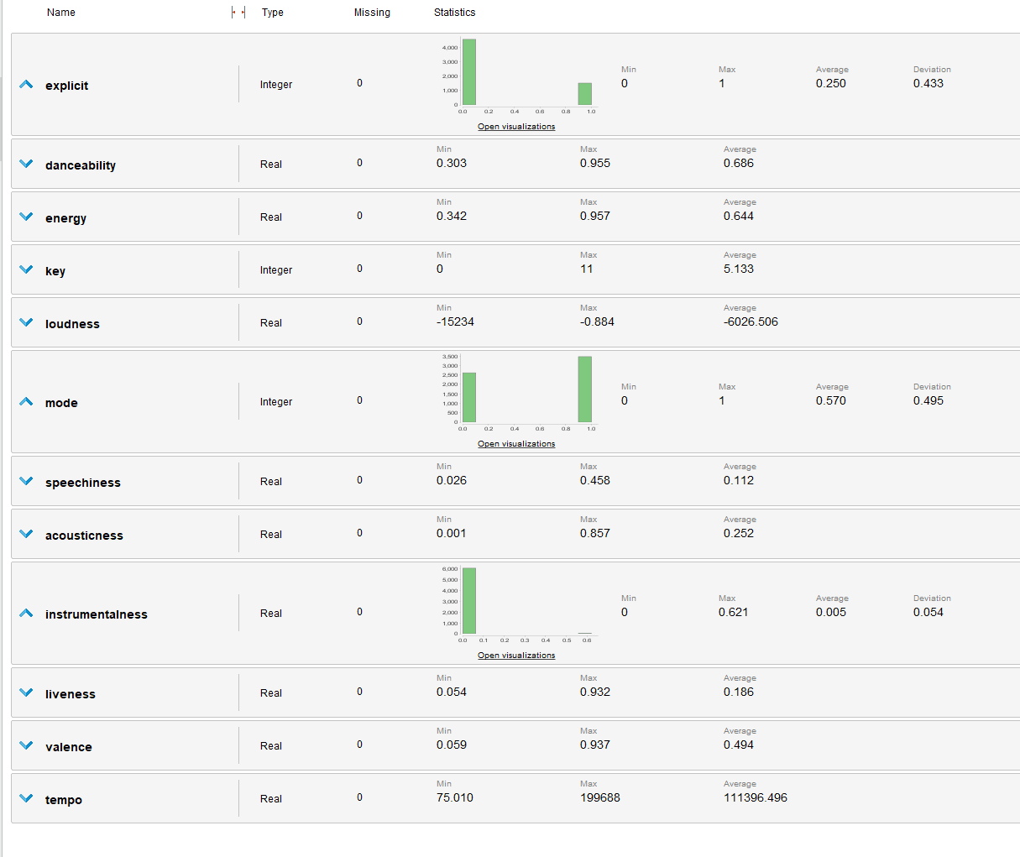
FP Growth – Imbalanced Attributes

Slide 11
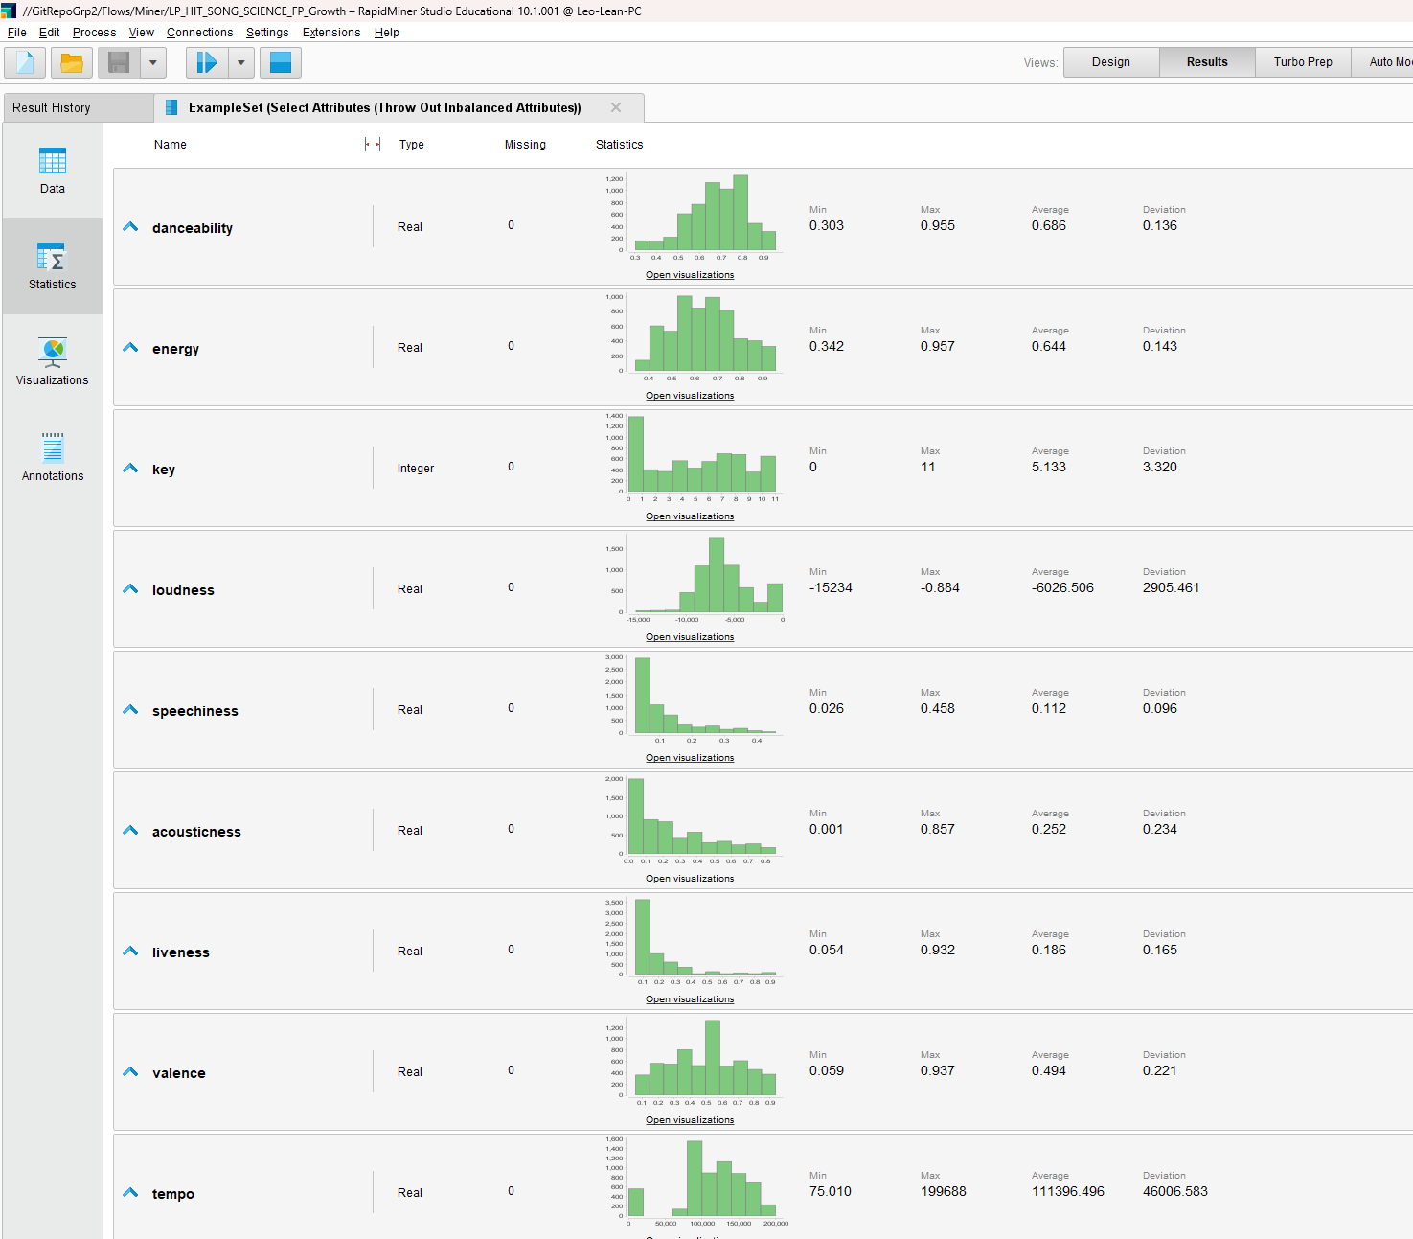
FP Growth – Remaining Attributes

Slide 12
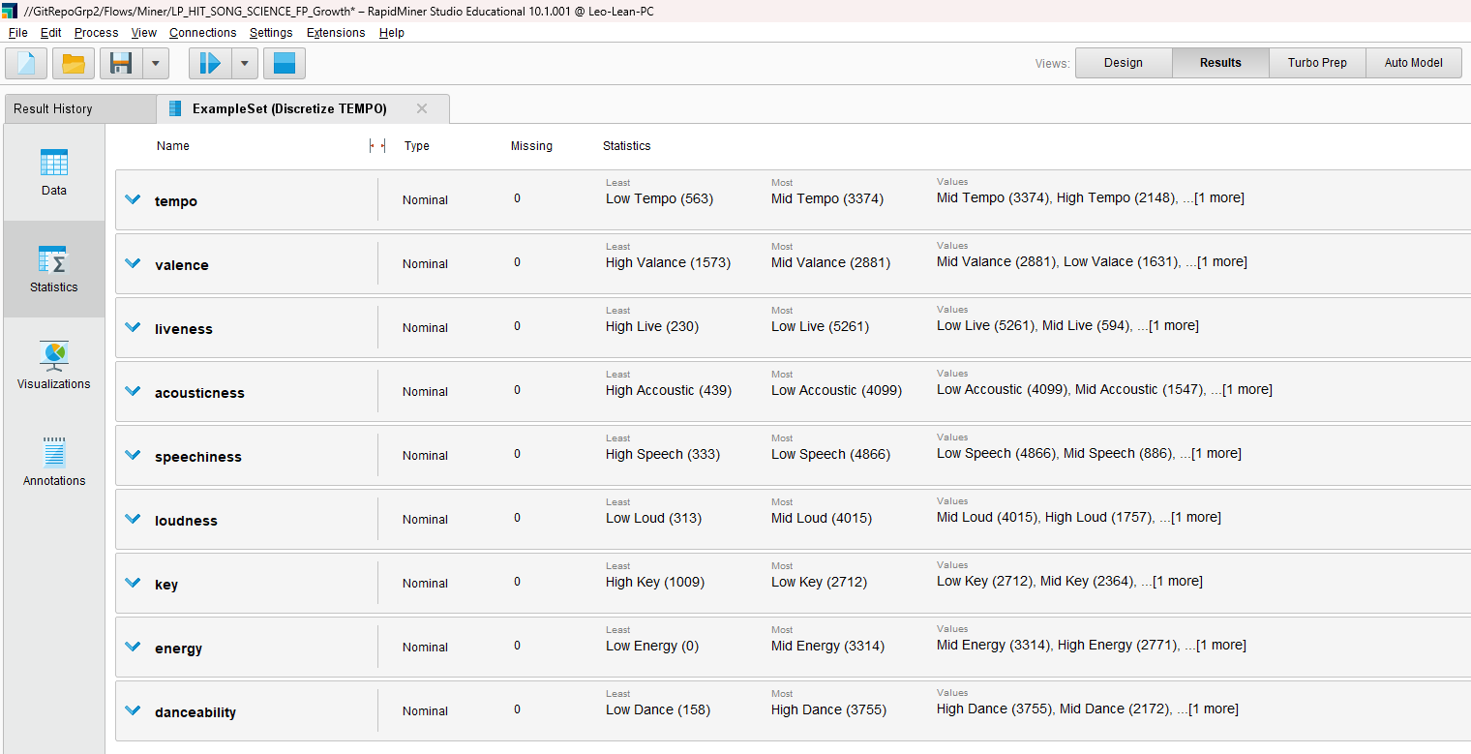
FP Growth – Binning Result

Slide 13
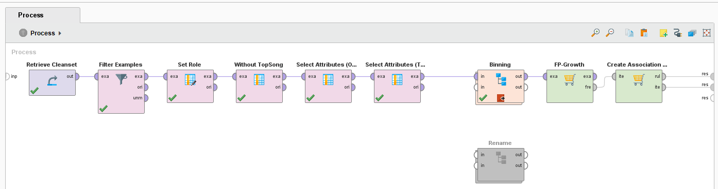
FP Growth – ProcesS

Slide 14
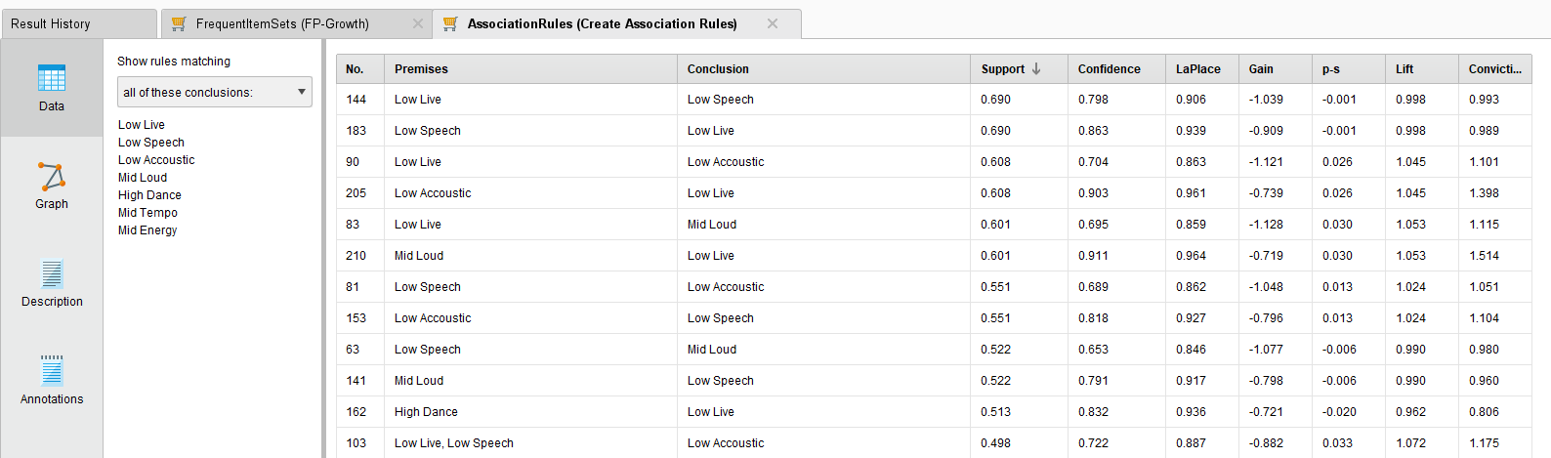
FP Growth – Result

Slide 15
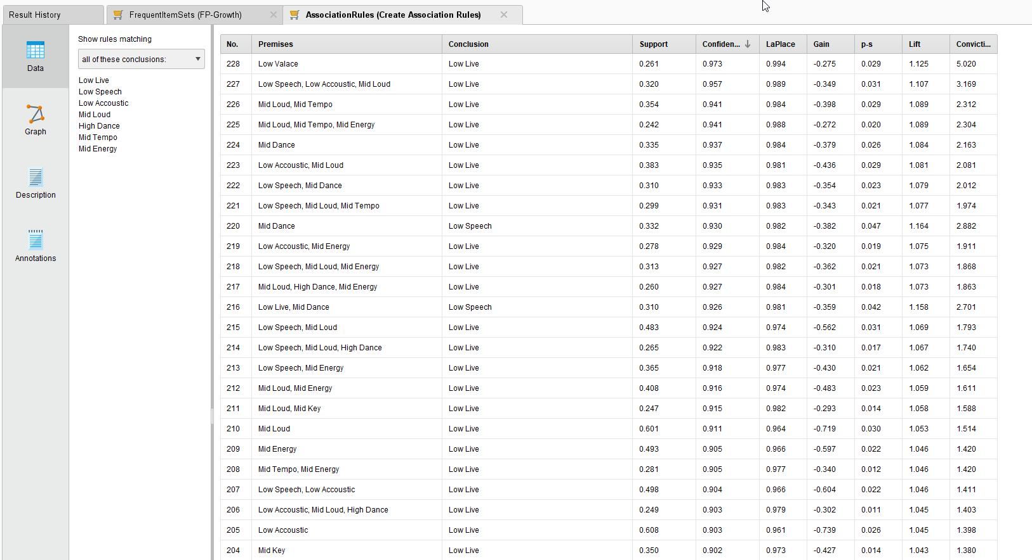
FP Growth – Result (TRUE) (First Round)

Slide 16
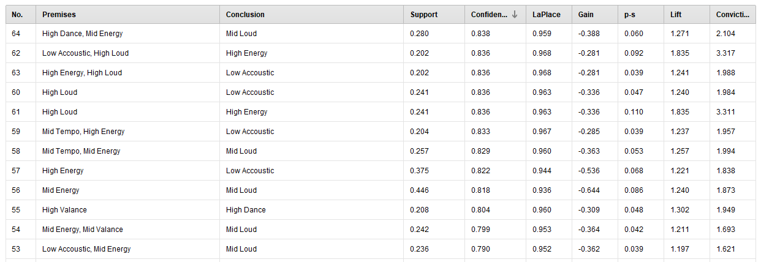
FP Growth – Result (TRUE) (Second Round)

Slide 17
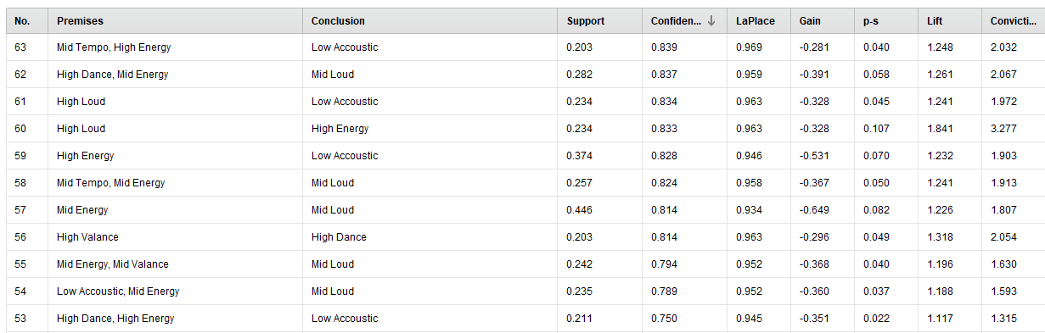
FP Growth – Result (False)

Slide 18
FP Growth – Result (False)

Slide 19
Random forest is the best performing model
SVM & Random Forest alte Daten

Slide 20
The first iteration shows that we need to enrich our data
Two new data sets are needed to get following information:
artists.csv → Popularity of the artist
dict_artists.json → Recommendation of artists
JSON Data could not processed via RapidMiner, so we need to transform it Phyton to generate a local data whitch can be used with RapidMiner.

Slide 21
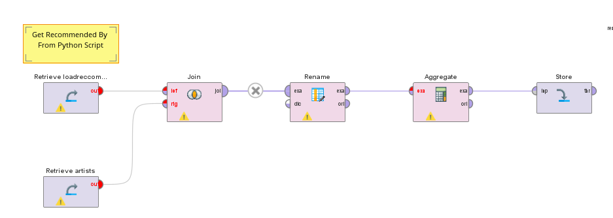
The first iteration shows that we need to enrich our data

Slide 22
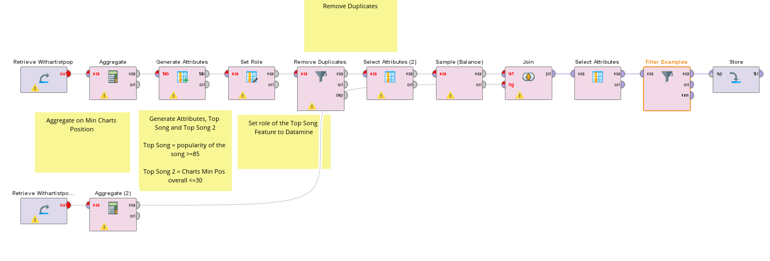
The first iteration shows that we need to enrich our data
Wird angepasst

Slide 23
Reflection
Genre: We did not differentiate between different genres, an improvement could be to research top songs in different genres separately (e.g pop, rock, rap,…)
Our datasets where not sufficient for those kind of research there where too special and too much genres (e.g Greek pop, Japanese R&B,..). But those Genres could be classified in similar groups, means of course a lot of effort and time.
Time: We could also made a time series analysis. In our model we do not take into account if there where also trends during the different years or decades. Also seasonal differences could be interesting (e.g. Christmas songs)*
We find out that the popularity factor increases a lot if the artist are recommended by popular artist, but we still don´t know how the factor of recommendations are built. We could investigate in that fact more. What are the factors that a song is listed as a recommended song? What is needed, that a artist will be recommended?
Notes:
Introduction to use case, goal, selection of data set

Slide 24
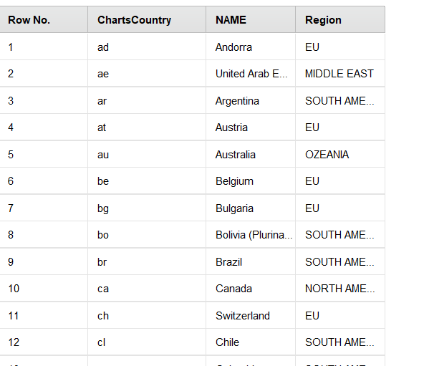
Reflection
We could also investigate more into clustering in different countries.
We started to do that and clustered charts in Regions and saw differences between different countries in accuracy for example but overall the results were not really good. We would need more data to have a reliable model.
Notes:
Introduction to use case, goal, selection of data set

Slide 25
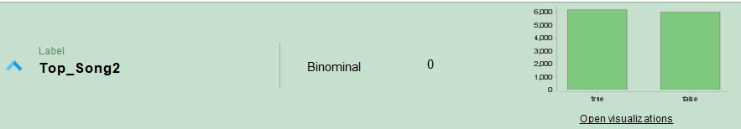
Reflection possible improvements in current Model setting
Sampling: We have join 2 data sets for sampling. Therefore we have 26.000 songs and only 6000 of them were top songs.
we will see in the next slide, that this is not sufficient for a real world data set
General pain point: It took really long to run our models (up to 1 day), so to see the result of an adjustment, take really long
We are unsure, if we are overfitting with our model ( see real world example in the next slide)
Notes:
Introduction to use case, goal, selection of data set

Slide 26
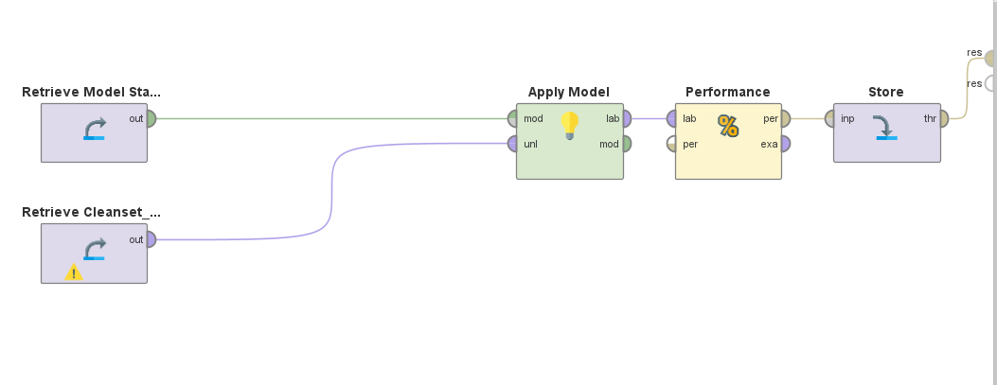
Reflection Apply MODEL on real World data
Notes:
Introduction to use case, goal, selection of data set

Slide 27
Reflection Apply MODEL on real World data
We identify nearly all top songs
But we also identify a lot of songs which are not top songs
Notes:
Introduction to use case, goal, selection of data set

Slide 28
conclusion
It's important to note that predicting music popularity/top song is not an exact science, and there are many factors that can influence the success of a song, such as marketing, promotion, and timing. Nonetheless, by using data and machine learning algorithms, it's possible to identify songs that have a higher probability of becoming popular/top song, and to make informed decisions based on that prediction.
However, looking to our real world data, our model seems to be not that bad, now we have to investigate more to ensure, that there is no overfitting.
Notes:
Introduction to use case, goal, selection of data set

